Slide 1
Satellite Communication
Submitted By:
Md Joynal Abedin Joy
ID: IT-21058
4th year 2nd Semester
ICT, MBSTU
Submitted To:
Dr. Md. Nazrul Islam Associate Professor Dept. of ICT, MBSTU

Slide 2
Introduction
Satellite Communication is a method of transmitting signals using artificial satellites.
It enables global communication even in remote areas.
Example: Live sports broadcasting, GPS navigation, weather forecasting.

Slide 3
What is Satellite communicatation?
Satellite Communication is a method of transmitting and receiving signals — such as voice, data, or video through artificial satellites that orbit the Earth.
This technology allows long-distance communication even between places where traditional networks (like cables or towers) cannot reach.

Slide 4
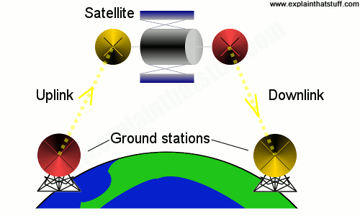
How Satellite Communication Works?
🔹 Uplink:
The uplink is the process of sending signals from an Earth station (ground station) to the satellite in space.
🔹 Downlink:
The downlink is the process of sending signals from the satellite back to another Earth station or user receiver.

Slide 5
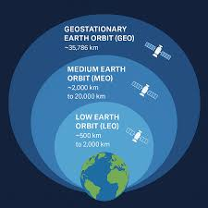
Types of Satellites:
Orbit Type | Altitude | Features | Example
GEO | 36,000 Km | Fixed over one location | TV Broadcasting
MEO | 10,000 Km | Moderate speed and delay | GPS
LEO | 500–2,000KM | Fast orbit, low latency | Starlink

Slide 6
Components of a Satellite Communication System:
Space Segment: Satellite, transponder, antennas.
Ground Segment: Earth stations and control centers.
User Segment: Devices receiving or sending data (TV, GPS, etc.).

Slide 7
Applications:
Television broadcasting (DTH services).
Internet and telecommunication.
GPS navigation systems.
Weather forecasting and disaster management.
Military and scientific research.

Slide 8
Advantages :
Global Coverage: Satellites can cover the entire Earth, including remote or rural areas where cables and towers can’t reach.
Long-Distance Transmission: Signals can travel thousands of kilometers quickly using satellites.
Broadcast Capability: A single satellite can send signals to millions of receivers at once (like TV broadcasting).
Useful for Navigation and Weather: Helps in GPS systems, weather forecasting, and disaster monitoring.

Slide 9
Disadvantages:
High Cost: Launching, maintaining, and replacing satellites is very expensive.
Signal Delay (Latency): GEO satellites are far from Earth (~36,000 km), causing slight time delays in communication.
Signal Interference: Weather conditions like rain or storms can weaken satellite signals (known as rain fade).
Complex Technology: Requires advanced equipment and skilled personnel to operate and maintain.

Slide 10
Future of Satellite Communication
Use of Low Earth Orbit (LEO) satellites like Starlink for fast, low-latency internet.
Integration with 5G and 6G networks for global mobile coverage.
AI will make satellites smarter and more efficient.
Support for IoT devices in remote areas.
Smaller, cheaper satellites (CubeSats) will reduce costs.

Slide 11
Conclusion:
Satellite communication connects the entire world beyond physical boundaries.
It plays a vital role in broadcasting, navigation, and the modern digital world.
“From space to smartphones – satellites keep us connected.”

Slide 12
Thank You.

